Slide 1



Community Management
System
Group Number: 20
Pritesh Nimje (002817324)
Kamal Kotgire (002879990)
Neha Manjunath (002879249)
Chengjia Feng (002746829)
Yashvardhan Limbodiya (002284031)

Slide 2
Overview and Purpose
Modern communities generate vast amounts of data such as Resident info, visitor logs, maintenance requests, finances.
Efficient data management.
Centralized database system is key to:
Accurate data management
Secure data storage
Easy access for authorized personnel
Community management system has various benefits for living Community.
Streamline the management of resident data, amenities, visitor logs, and staff records to enhance operational efficiency.
Enable accurate and transparent handling of financial transactions and maintenance charges for trust and accountability.
Provide a responsive and effective system for managing service requests and complaints, ensuring timely resolution and improved resident satisfaction.
Implement robust strategy for tracking and managing visitors and vehicles, ensuring a secure living environment.
Ensure the security and accessibility of data to support informed decision-making for efficient community administration.

Slide 3
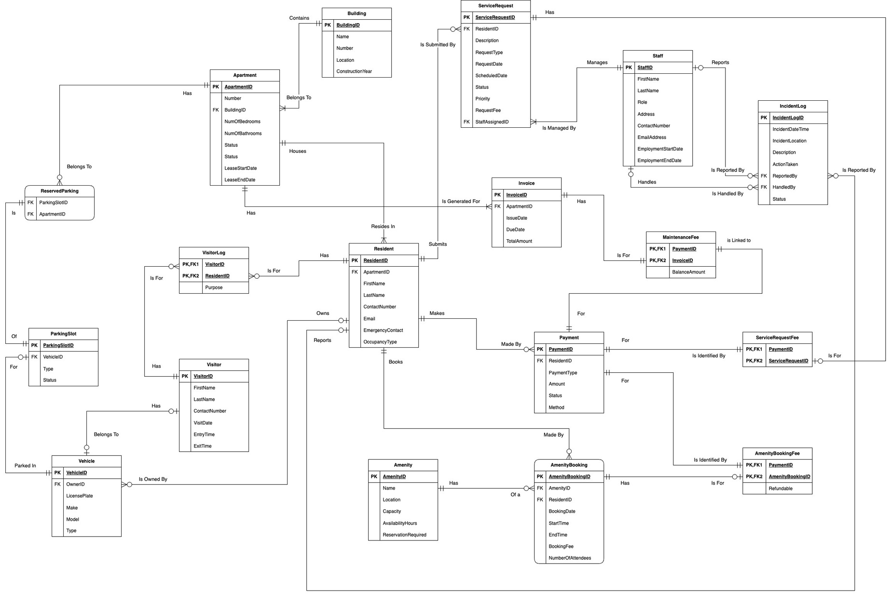
Final ERD

Slide 4
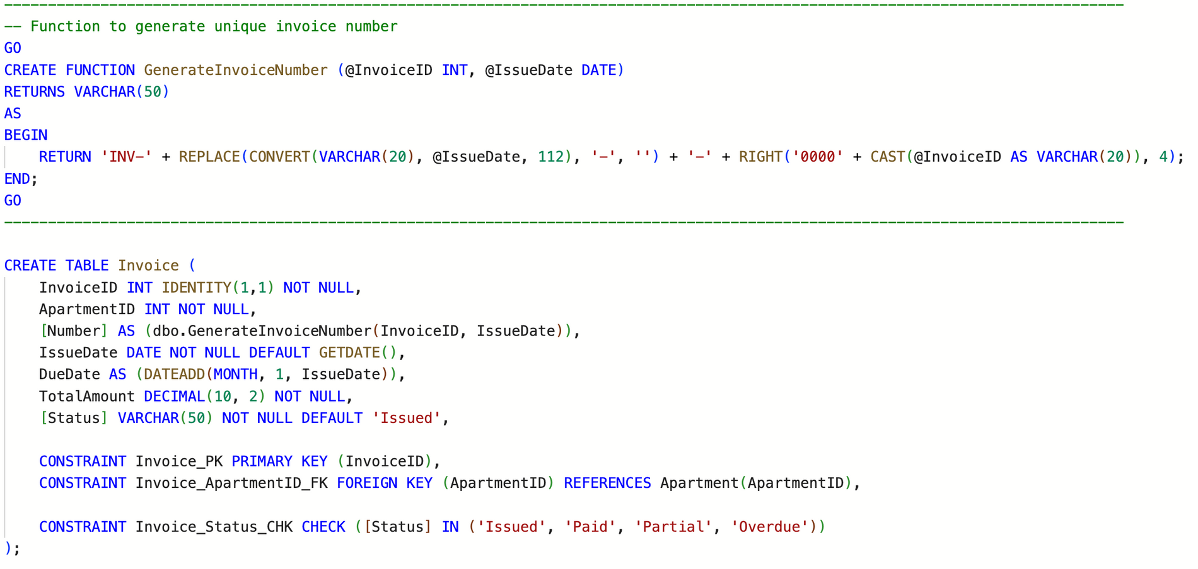
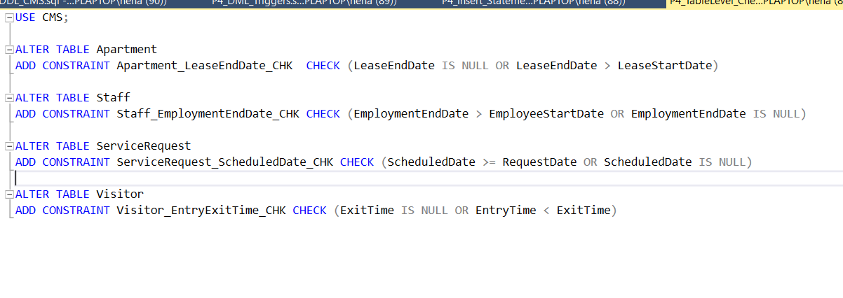
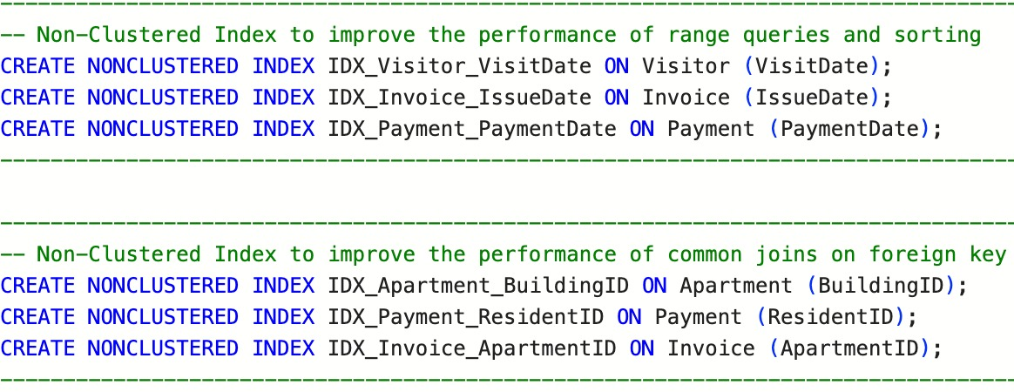
DDL Statements

Slide 5
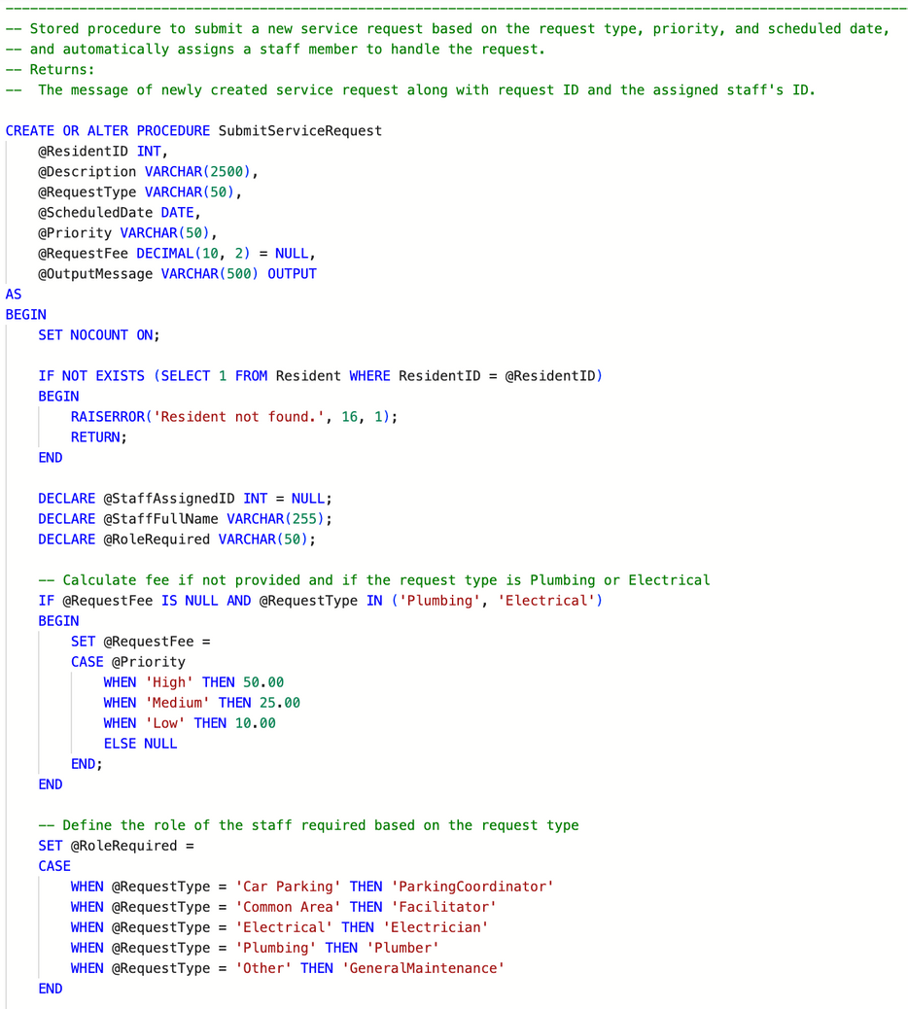
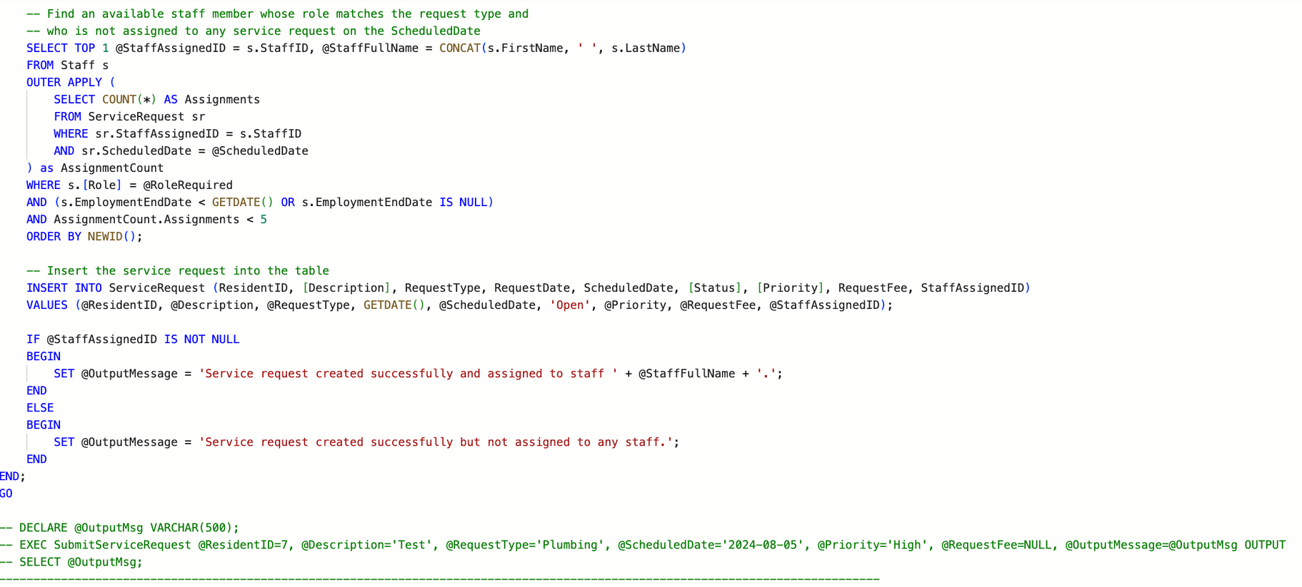
Stored Procedures (Service Requests)

Slide 6
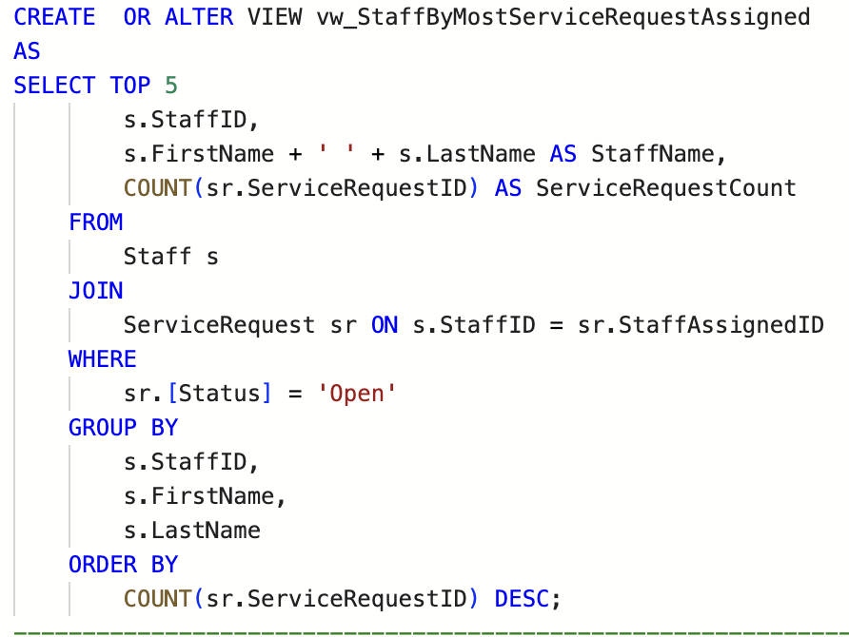
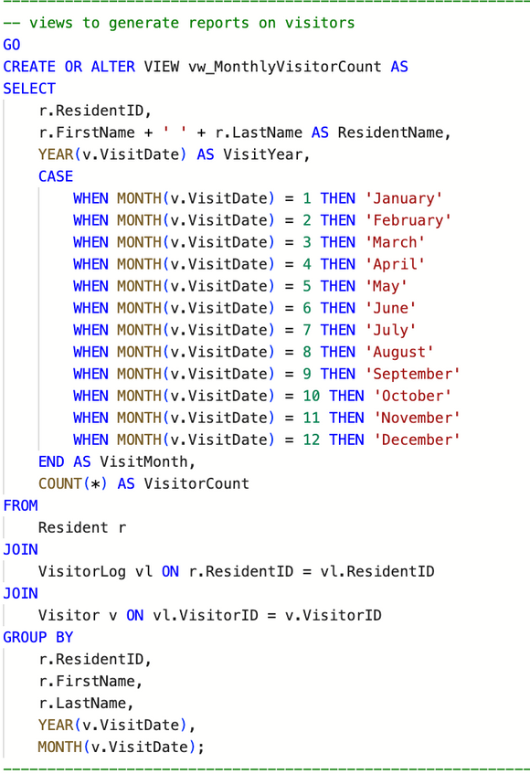
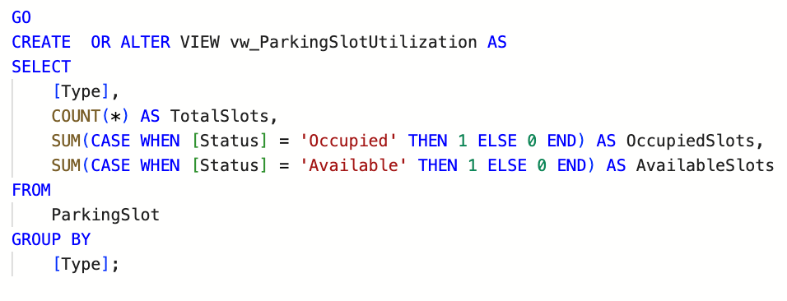
Views

Slide 7
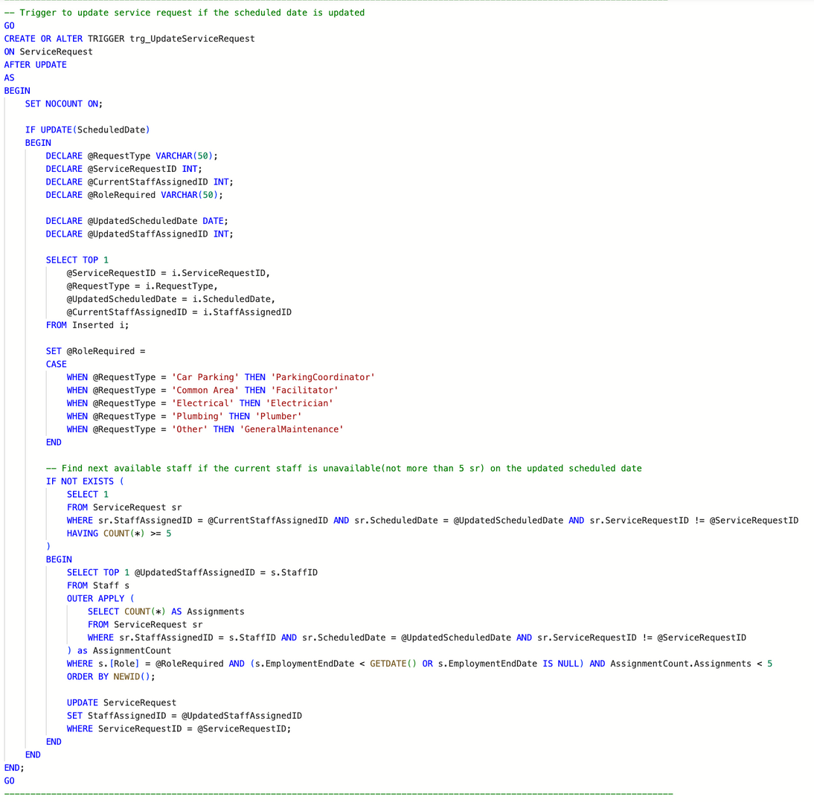
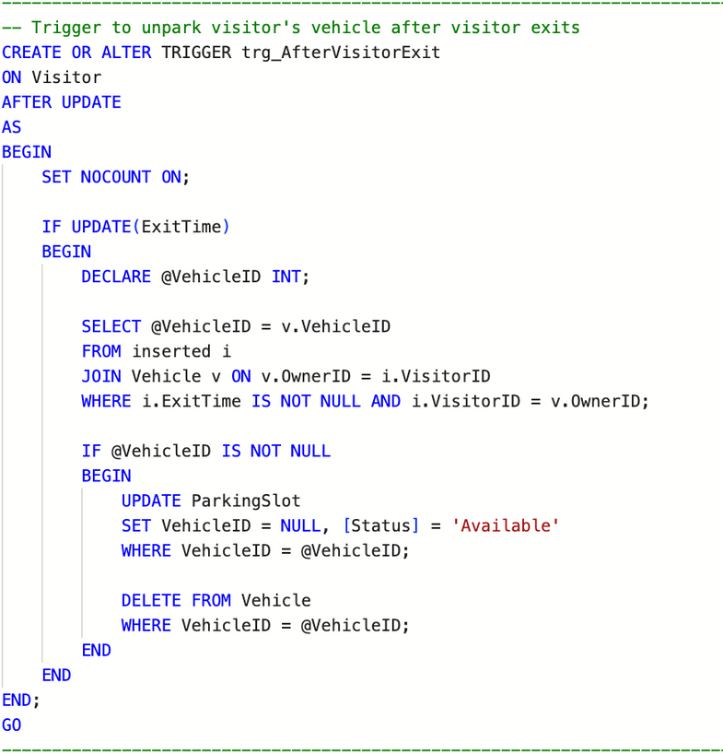
Triggers

Slide 8
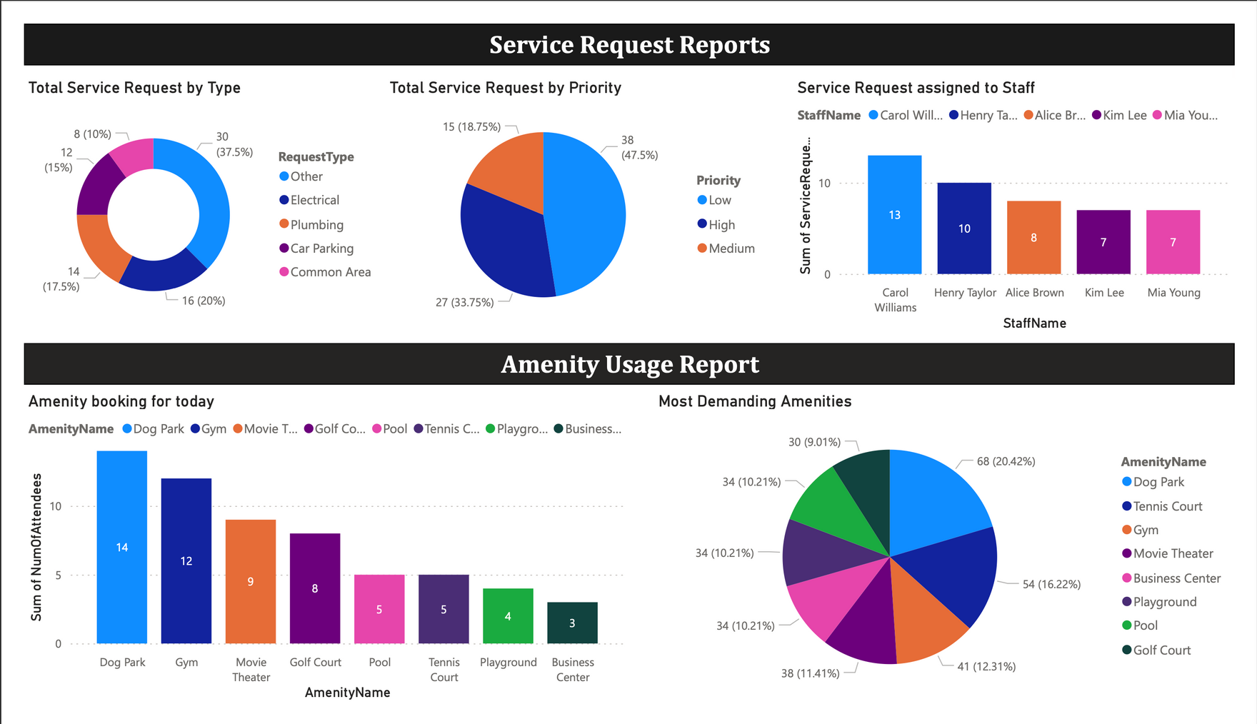
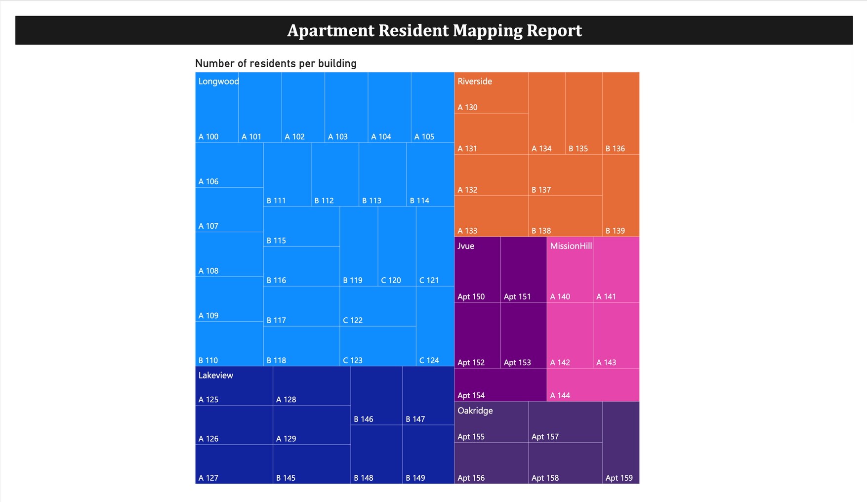
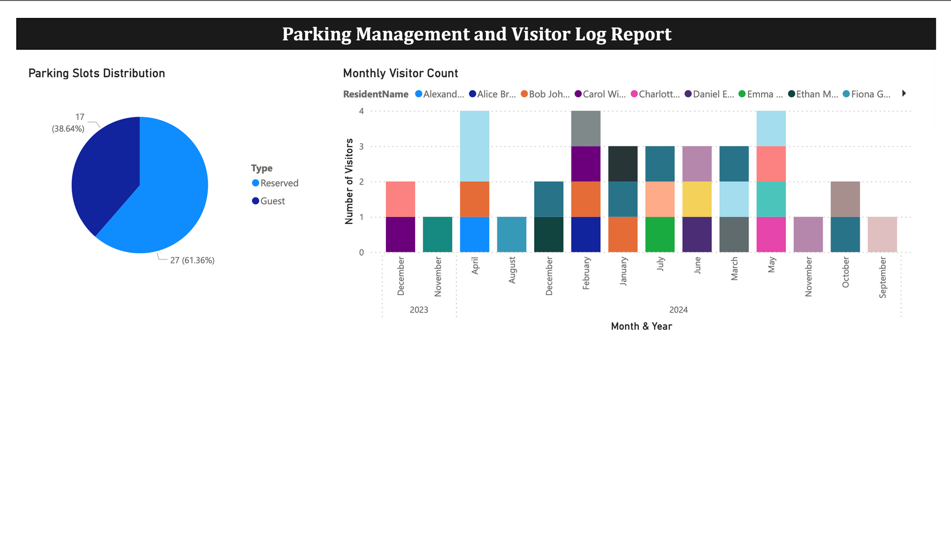
Data Visualization

